Slide 1

Programming I Lecture 1
Instructor: Kia Babashahi Ashtiani
Fall 2020
Vanier College

Slide 2
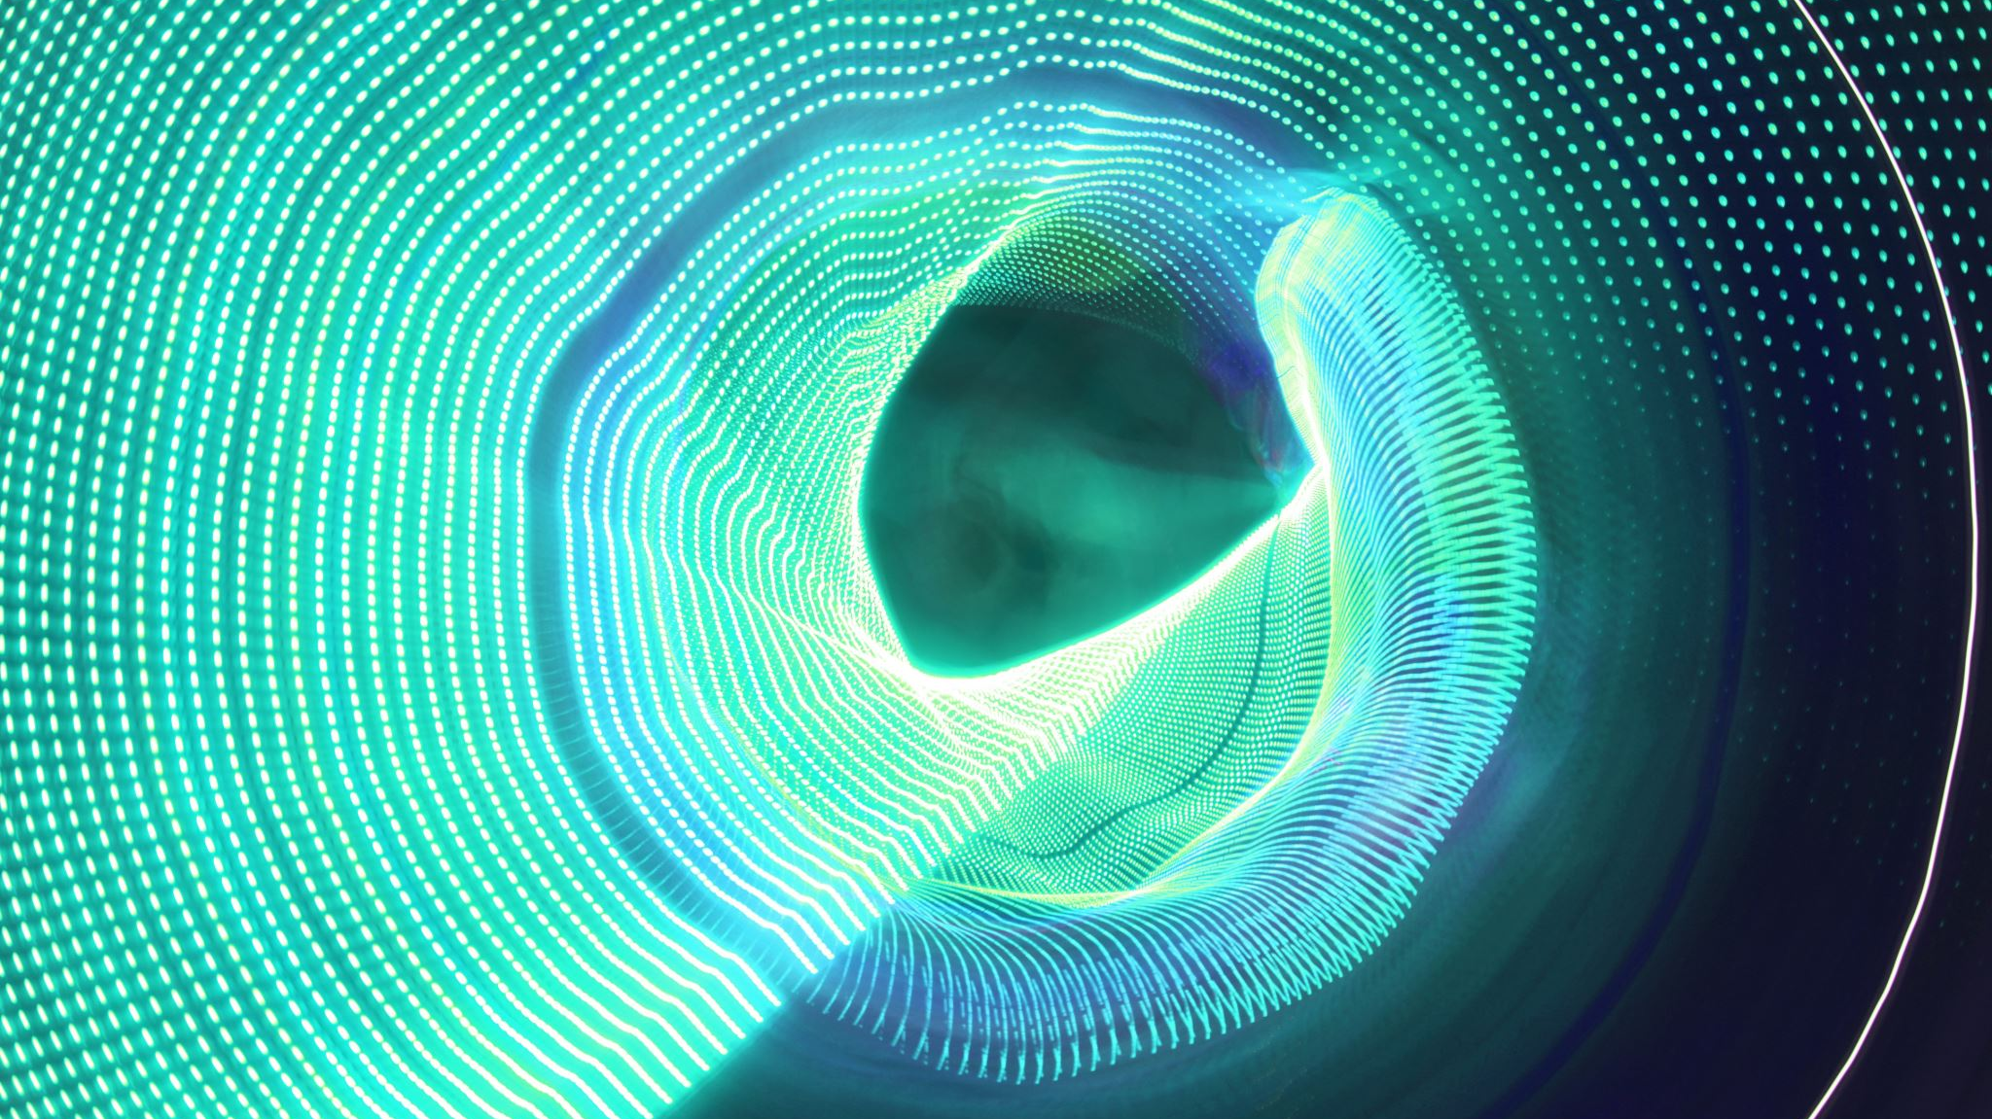
Programming one
Computers
Different types of computers
Computer components
Memory
ASCII code

Slide 3
What is a computer?
A machine capable of carrying out arithmetic and logical operations using computer programming i.e., doing computation.
Tablets, cellphones, smart watches, vending machines, ATM machines,… .
Alan Turing, Charles Babbage, …
Make life easier by doing extremely large amount of computation in a matter of seconds.
Save lives like MRI machines, Covid Alert,…..

Slide 4
History
Muhammad ibn Musa al-Khwarizmi introduced the concept of algorithms.
Algorithms are the backbone of Computer Science.
Lots of mathematicians such as Church and Godel.
Charles Babbage Designed the first computer.
Modern day computers are based on what we called Turing machines.
Alan Turing a mathematician, war hero and the father of modern computer science. (WWII).

Slide 5
Different computer types
Laptops
Desktop computers
Tablets
Notebooks
Mobile devises
Smart watches
Super computers

Slide 6
Components
Hardware: The body
Software : The mind and soul

Slide 7
Hardware: What you can physically see and touch
Mouse
Keyboard
Mother board: Containing the essential electrical devices of the machine
Processors
Case
Desktop
Hardware and electrical engineering.

Slide 8
Software
Groups of data and computer instructions that make the machine finish its desired task.
Microsoft word
Microsoft Power point
Google maps
Games
Oracle
Net Beans
Eclipse
Itunes

Slide 9
Input1: Oxygen of the machine.
Electricity is an input to the machine.
Analog(continues) and digital(discrete 0,1).
Computers work with digital signals ,i.e., zero and one.

Slide 10
Input
You can use input devices to feed the information you want to the machine
Mouse,
Keyboard,
Microphone,
Scanner,
Webcam,
….

Slide 11
Output
The result of some computation.
It can be hidden or displayed.
The display is done via output devices such as:
Headsets,
Monitor,
Microphone,
Speaker,
….

Slide 12
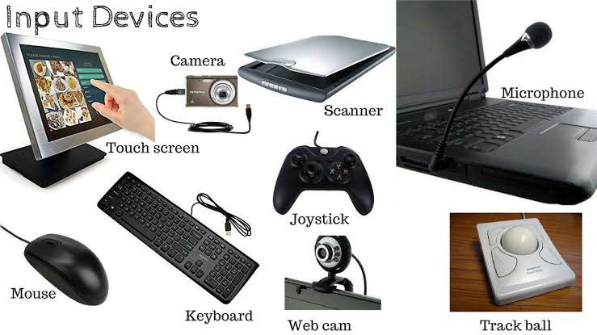
Some input devices
Picture taken from Here

Slide 13
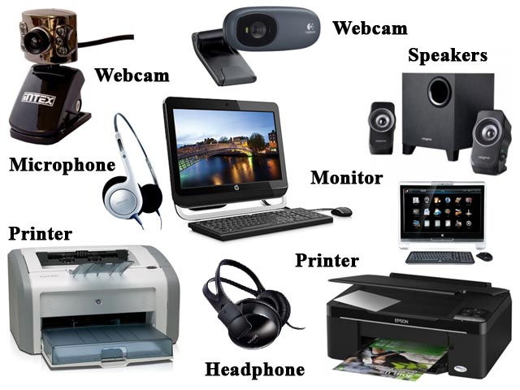
Output devices
Picture taken from Here
Webcams in general are input devices but some of them might come with microphones so it can be considered both input and output in special cases

Slide 14
ASCII codes and Binary numbers
How should we communicate with something that only understands zero and one?
Can we translate our words and our numbers to the language of zero and one?
BASE TWO!! What is that!!!???
Binary numbers (OMG MATHEMATICSSSS ☹ ☹)
ASCII stands for American Standard Code for Information Interchange

Slide 15
But really, why do we count from one to ten?!
I mean most people are born with ten fingers, right?
Lets assume we have some apples. We want to divide them in groups of two.
If we have one apple how many groups of two will we see? None!
If we have two apples, what then? 1. How many apples are left? 0
If we have three apples? One group of two and then one group of one.
Now lets assume I have one apple. How many groups of ten apples do I have?
What about having two apples? … how about 9 apples?
If I have 10 apples, then I can group them in one group of ten and nothing will be left.
What about 44 apples?

Slide 16
The number of apples remain the same!!
Pay attention that you have the same number of apples. You are just grouping them in different groups.
One time groups of size two.
One time groups of size ten.
Grouping numbers in groups of ten and allowing numbers from 0-9 to appear in the remainder is done in the base ten system.
Grouping numbers in groups of two and only allowing zero and one to appear in the remainder is done in the base two system.
Representing a number in base two is also referred to as representing the number in its binary form or the binary representation of a number.

Slide 17
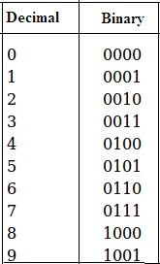
Decimal to Binary
The figure was taken from Here

Slide 18
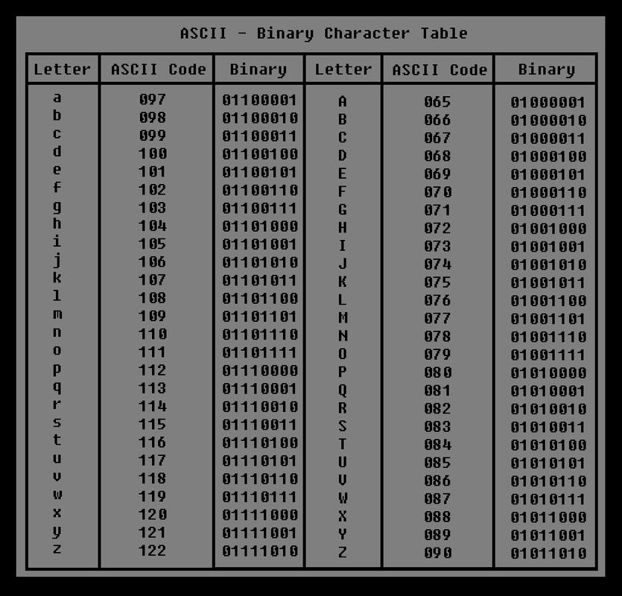
ASCII
Picture taken from
Here

Slide 19
Hexadecimal
Numbers represented in base 16.
0,1,2,3,4,5,6,7,8,9,A,B,C,D,E,F
The logic of converting the numbers is the same as binary. Each has its own application.
How do we show F in binary? 1111

Slide 20
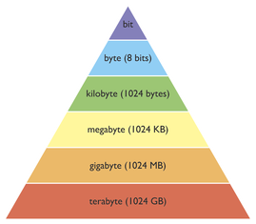
Bit, Bytes, Kilobytes, …
Picture taken from
Here

Slide 21
Memory
Where you store the data and access it.
The two types of memory.
Volatile
Nonvolatile

Slide 22
RAM= Random Access Memory
Can be read or changed in any order
Machine code is applied to play with it.
Quickly access the information anywhere in the memory. Almost the same speed of access at cell 0 or at cell 1000.
It is faster to read and write at given locations than other types of memory. Yet, it does not allow us to store as much data as we can do using other types of memories like disks.

Slide 23
Volatile memory
Electricity dependent.
Electricity shut down == Loss of data. My generation has suffered from it.
RAM: Random Access Memory
Cache.

Slide 24
Nonvolatile memory
Does not need to be connected to electricity to store the data.
USB
Hard Drive
ROM: Read Only Memory
CD
DVD

Slide 25
What is next?
Next class we will focus on Algorithms and flowcharts.
We will talk about programming languages, compiling, and machine languages
We will talk about Java and how to install it

